Slide 1
PES-319
SOFT SKILLS
AROHI KHAJURIA

Slide 2
ATTITUDE BUILDING AND GOAL SETTING

Slide 3

Attitude
View Point
Mind set
Opinion or stand point
Only regarding particular thing and situation
Prone to change
Word choice, sentence structure, figurative language

Slide 4

Attitude Vs Behaviour
Behaviour
Way in which person acts, implies actions, moves etc
Can be seen and heard
Depends upon attitude, character traits
External trait
What you do
Attitude
Person’s opinion regarding someone or something
Influenced by surrounding, experiences, moral values
Internal trait
Simply what you think or feel

Slide 5
Importance of Attitude
Helps you cope more easily with the daily affairs of life
Excel your health, social life, earning potential, productivity, ability to overcome obstacles
Creating enormous benefits that can significantly improve the quality of your life
Helpful team player with a positive outlook
Can make all the difference in whether you get the job or a rejection letter

Slide 6

Personality Traits
Characteristics and qualities that help define you as a unique individual
Mathematical capability
Logical thinking and reasoning
Creative thinking
Effective communication
Collaborative spirit
Curiosity
Problem solving
Attention to detail
Constant learner

Slide 7
TIPS TO BUILD POSITIVE ATTITUDE
Practice gratitude
Describe yourself with positive words
Surround yourself with positive people
Start meditating every day
Don't expect results
Try to make other people feel happy
Practice handling rejection

Slide 8
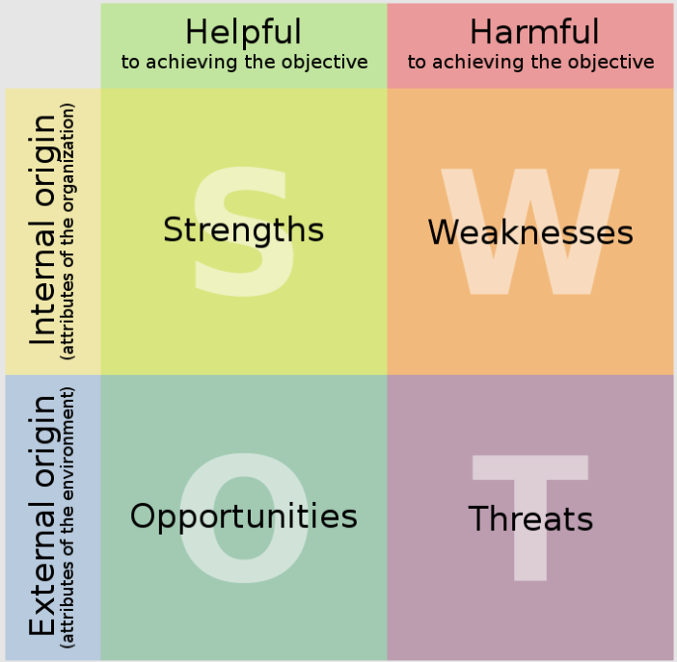
SWOT Analysis

Slide 9
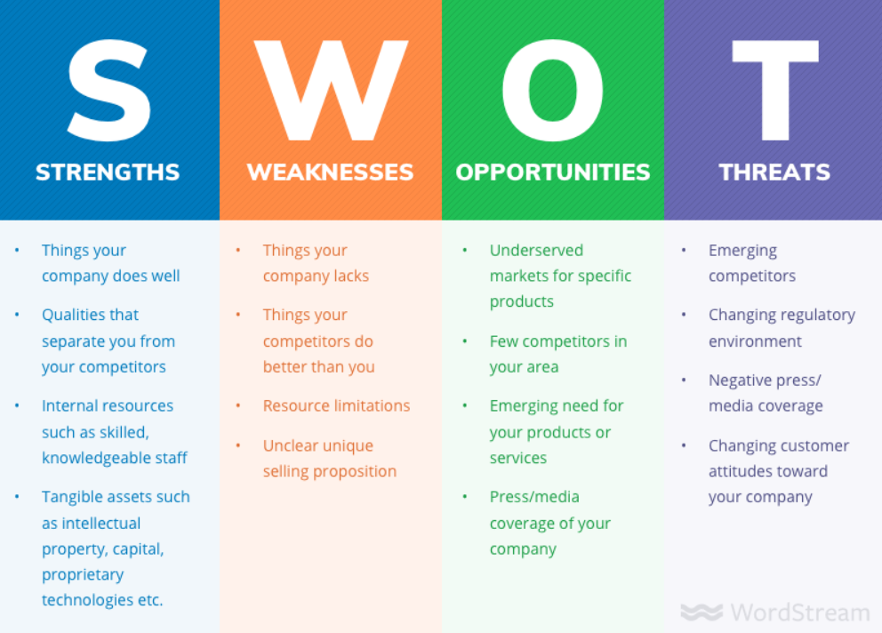

Slide 10
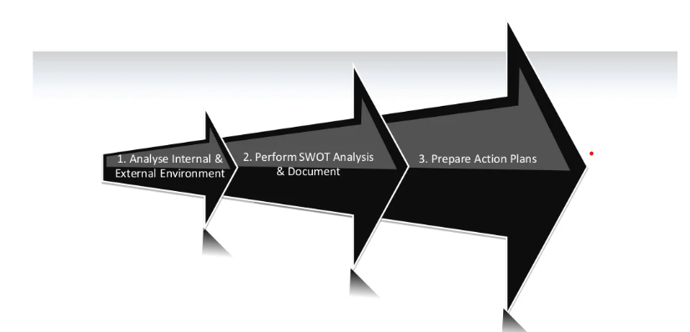
ACTION PLAN
Things that must be addressed immediately
Things that can be controlled now
Things that should be explored further
Things that should be planned for the future

Slide 11
THANKYOU

